Slide 1
FDI and Technology Spillovers
Jiaxi Zhang

Slide 2
Foreign Direct Investment and Technology Spillovers: Evidence from Panel Data Analysis of Manufacturing Firms in Zambia -- Samuel Mulenga Bwalya
Foreign Direct Investment in Vietnam: Is There Any Evidence of Technological Spillover Effects -- Nguyen Ngoc Anh* and Nguyen Thang†, Le Dang Trung† , Pham Quang Ngoc*, Nguyen Dinh Chuc*, and Nguyen Duc Nhat*
Notes:
Either of them include some characters the other one didn’t. So that’s the reason I want to present them together.
And If I didn’t clearify the paper, it means both of them are included

Slide 3
Reason for providing fiscal incentives to attract foreign direct investment:
FDI is an effective conduit for technology transfer through technology spillovers to domestically owned firms in the host country. (Zambia)
Attracting FDI has become an important element of economic and industrial development strategies for many developing countries. (Vietnam)
Notes:
They have similar start point.

Slide 4
FDI can help improve the economic prospects of most African countries in several ways. (Zambia)
FDI is a non-debt source of development finance, helps to fund investment projects in the host economy.
FDI increases the level of technical progress in the host country, which can play a decisive role in the process of economic development.
Technology transferred to developing countries via FDI tends to be newer than that transferred via licensing.

Slide 5
Multinational corporations bring along capital, technology, managerial and marketing skills and its global network which contribute significantly to a host country’s economic growth. (Vietnam)
The technology transfer could be broadly defined as managerial practices, production methods, marketing techniques or any other knowledge embodied in a product or service

Slide 6
Hypotheses
Sectoral Spillover
Intra-Industry Spillover (Horizontal)
Inter-Industry Spillover (Vertical)
Regional Spillover
Technology spillovers may be regional rather than sectoral, suggesting that industrial clustering may speed up the rate of technology diffusion to local firms. (Zambia)
Notes:
The spillover effects could be divided into intra-industry effect and inter-industry effect. And Both of these papers have a very clear explanation.
In Zambia’s paper, they found that regional concentration of foreign investment facilitates rapid technology spillover from
foreign firms to domestic firms in the manufacturing sector.

Slide 7
Intro-Industry Spillover
Demonstration effect (+) the ‘imitation’ channel of spillover or ‘learning-by-watching effect’ (Jutta Gunther, 2002).
Competition effect (+) forcing rival domestic firms to upgrade production techniques in order to remain competitive and productive (Blomstrom and Kokko,1997).
Labor Mobility effect (+) the movement of highly trained and skilled staff from foreign firms to domestic firms (Aitken and Harrison, 1999 )
Notes:
And as for the competition effect, I made a small extension of a model to measure the competition effect theoretically, however, it is in another story, but it is also an issue of technology spillover.

Slide 8
Negative Intro-Industry Spillover Effect
Market stealing effect (Vietnam): As MNCs enter the market, their advantages on technology and know-how may take in the market of the domestic firms and make them produce in less efficient scales, which leads to less productiveness of domestic firms.
Notes:
This Market stealing effect is just a negative competition effect. The model I will show later on is a kind of this negative market stealing effect.

Slide 9
Inter-Industry Spillover
Spillover through backward linkages (+) Multinational corporations (MNC) may contribute to technology improvement of their local suppliers or potential suppliers by offering technical assistance and supports to these firms
Spillover through forward linkages (+) MNCs may also provide training and other types of technical support to their customers. (Vietnam)
Notes:
Zambia’s paper only includes the spillover through backward linkage. And they have a very different result from Vietnam’s paper. And I will mention it later on.

Slide 10
Data & Methodology
Zambia Manufacturing sector Firm level data from 1993 to 1995 *Regional Effect
Vietnam Manufacturing & Service sector Firm level data from 2000 to 2005 *Service sector
Notes:
I will separate into two parts to make sure it won’t cause any confusions.

Slide 11
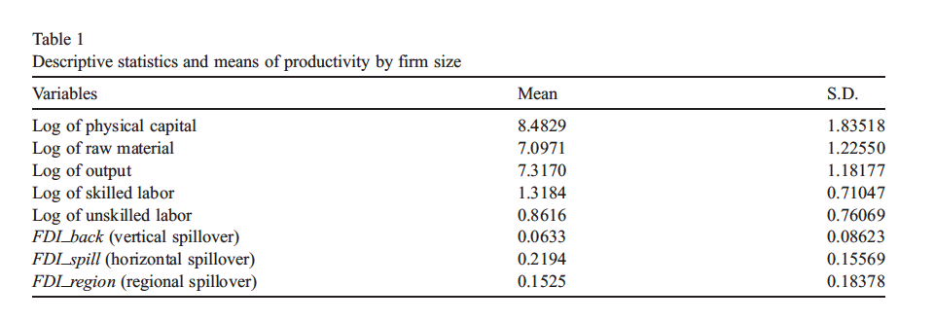
Zambia
Annual data on Zambian manufacturing firms collected by the World Bank through the Regional Program on Enterprise Development (RPED) survey from 1993 to 1995.

Slide 12
FDI_spill (horizontal spillover), defined as a ratio of labor employed by foreign firms to total labor in the sector captures horizontal (intra-industry) productivity spillovers.
FDI_region (regional spillover), defined as a ratio of sales of foreign firms to total sales in the region
FDI_back (vertical spillover), defined as the proportion of the output produced by downstream sectors and supplied to upstream sectors

Slide 13
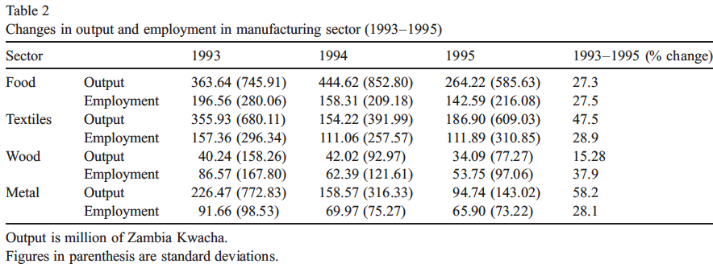
Output and employment in four two-digit manufacturing industries between 1993 and 1995.
Notes:
It is shown that employment and output declined throughout the survey
period. This decline coincides with the country's implementation of pro-liberal economic and
political reforms, which began in 1991. As a result, much of this decline can be attributed to
increased competition from imports following trade liberalization.

Slide 14
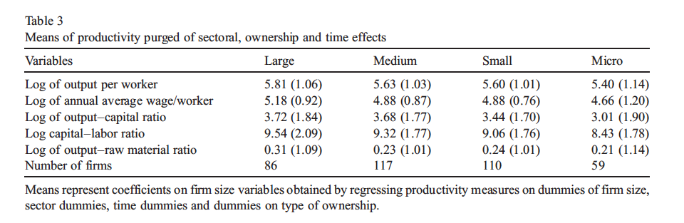
Definition of the firm size (No. of employees) micro < 6; 6 ≤ small ≤ 29; 30 ≤ medium ≤ 99; large > 99 employees

Slide 15

Methodology
Cobb-Douglas Production Function with constant return to Scale
y_{it} is the logarithm of output x_{kit} is the vector of logarithms of inputs v_{i} is unobserved firm-specific effects ε_{it} is the usual equation error term. y_{it−1} is the lagged logarithm of output included to capture the shock from past period (Nickell, 1996 ). α may be interpreted as the speed of adjustment to long-run output following a production or demand shock. β is the vector of input share parameters to be estimated.

Slide 16
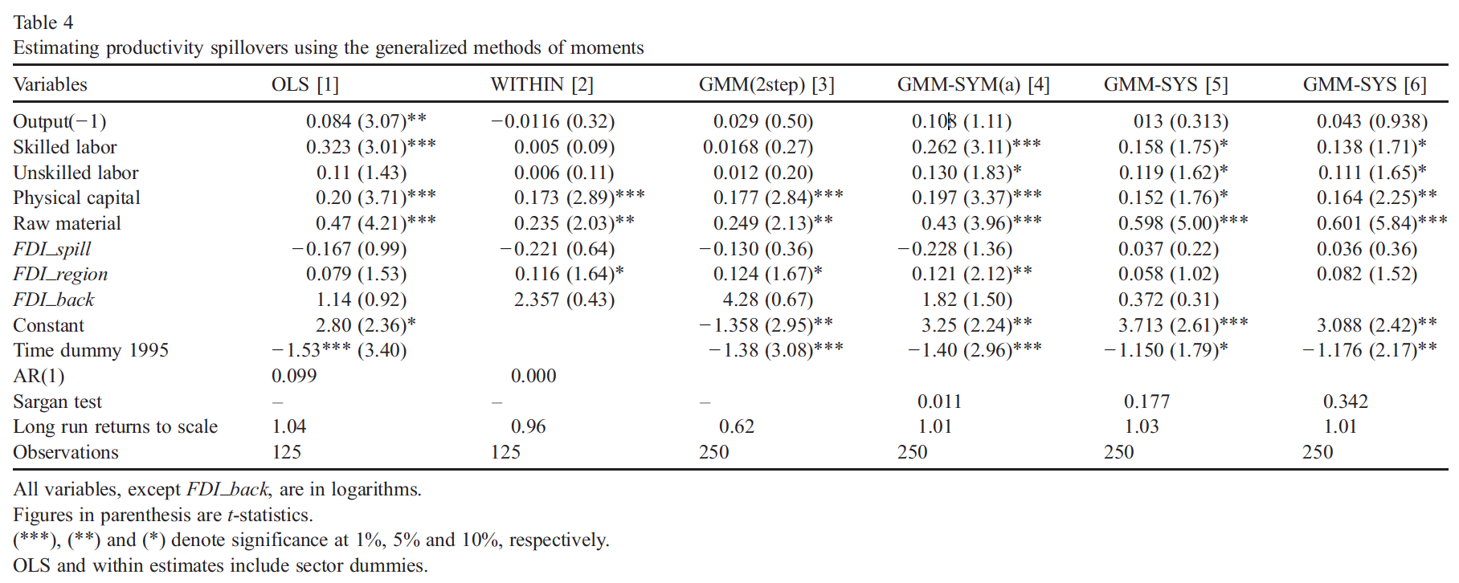
Total Sample
Notes:
Results from OLS and
fixed effects (within estimates) are presented in columns 1 and 2, and GMM estimates shown in
columns 3 through 6. Results in column 3 are those of the standard two-step GMM estimator
with robust standard errors corrected for finite sample biases. Column 4 reports SYS-GMM
estimates with robust standard errors. All other GMM estimates are based on a two-step SYSGMM
estimator with robust standard errors adjusted for finite sample biases as explained
above

Slide 17
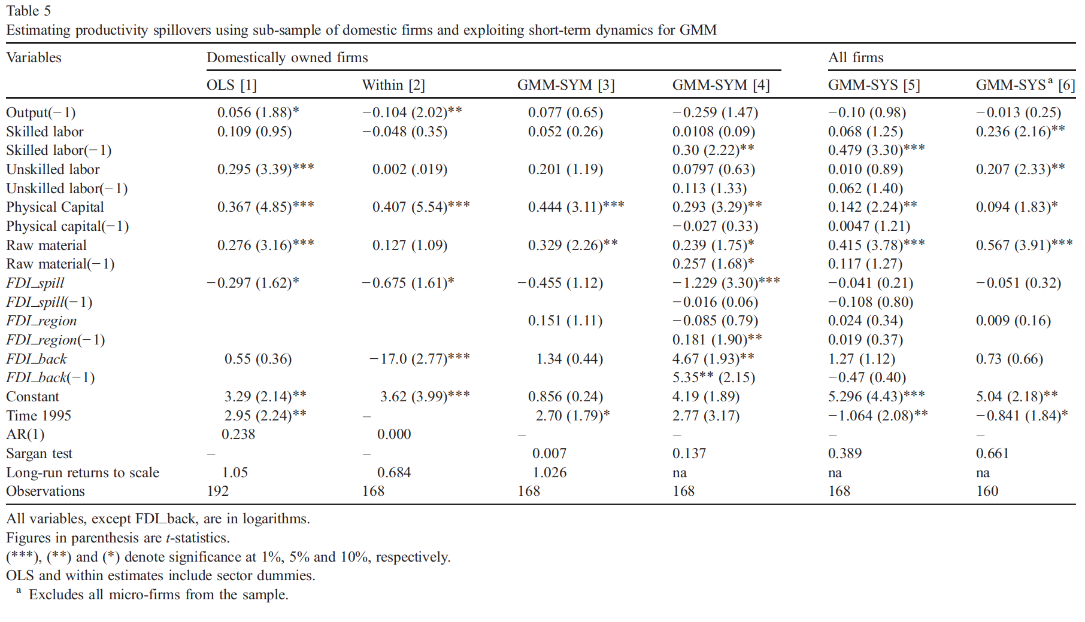
Sub-sample of domestic firms
Notes:
Adverse “ competition effects” can reduce productivity of domestic firms if foreign firms
attract away demand from their domestic counterparts

Slide 18
Conclusion
Negative horizontal spillover effect FDI will intensify the competition.
Positive vertical spillover effect. MNCs have an incentive to transfer knowledge to upstream firms to enable them produce intermediate inputs more efficiently.
Positive regional effect

Slide 19
Implication
Lack of intra-industry spillovers could be attributed to the discrimination of the fiscal incentives to MNCs.
Productivity loses arising from adverse competition effects within the sector should be weighted against any productivity gains from FDI.
This information can then be used to design a fiscal incentives to maximize productivity benefits from FDI.

Slide 20
Vietnam
Data
Census database from 2000 to 2005 General Statistical Office (GSO) of Vietnam
Manufacturing Sector Service Sector
Firm level

Slide 21
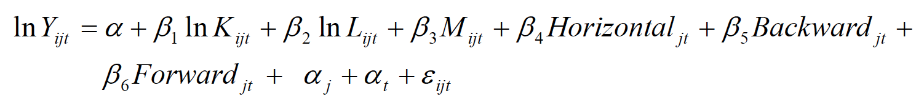
Methodology
Cobb-Douglas PF (CRS)
Y_{ijt} is the real output of firm i at time t operating in sector j. K_{ijt} is the capital of firm i at time t in sector j, which is defined as the value of assets at the beginning of the year. L_{ijt} is the measure of labour, defined as the number of employees. M_{ijt} are material inputs.

Slide 22
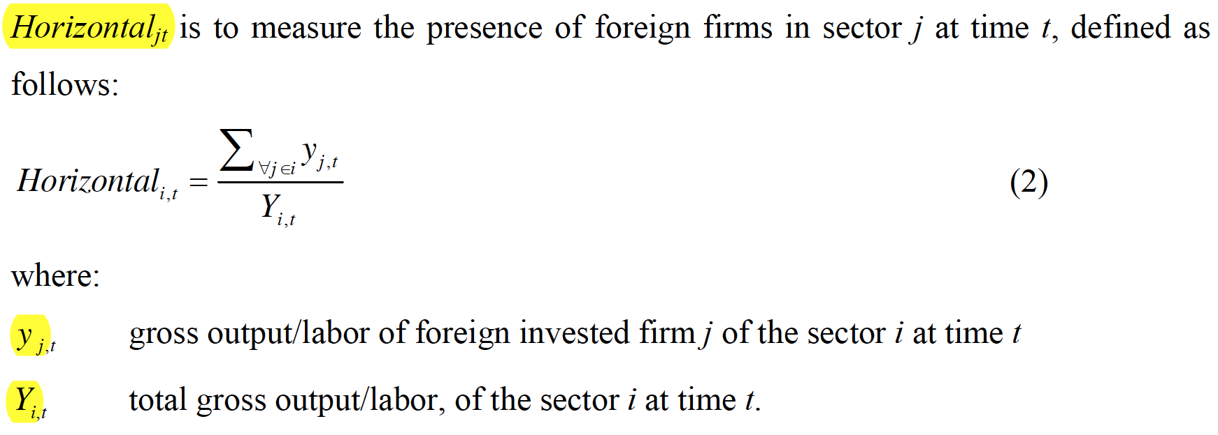

Slide 23
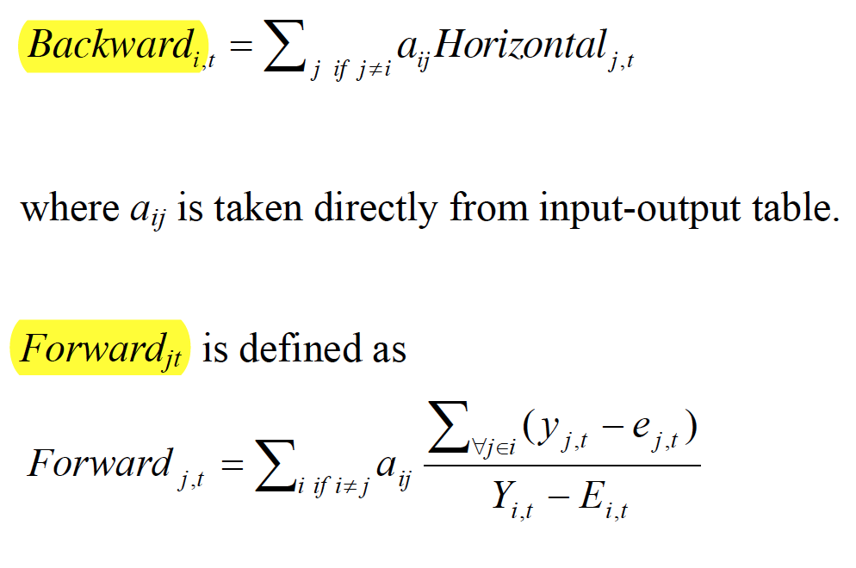
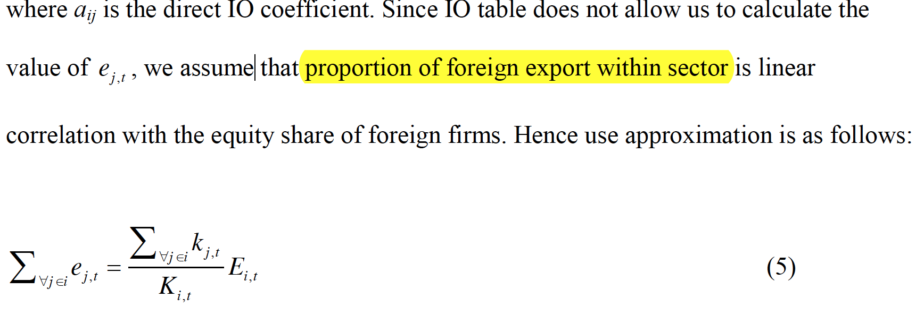

Slide 24
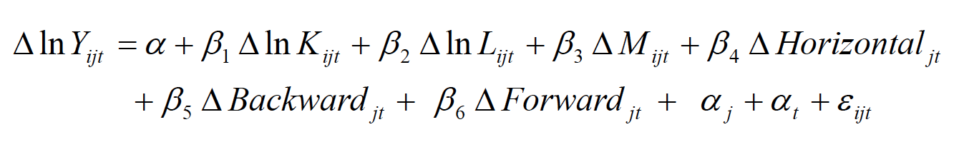
Methodology
POLS
RE
FE
FD

Slide 25
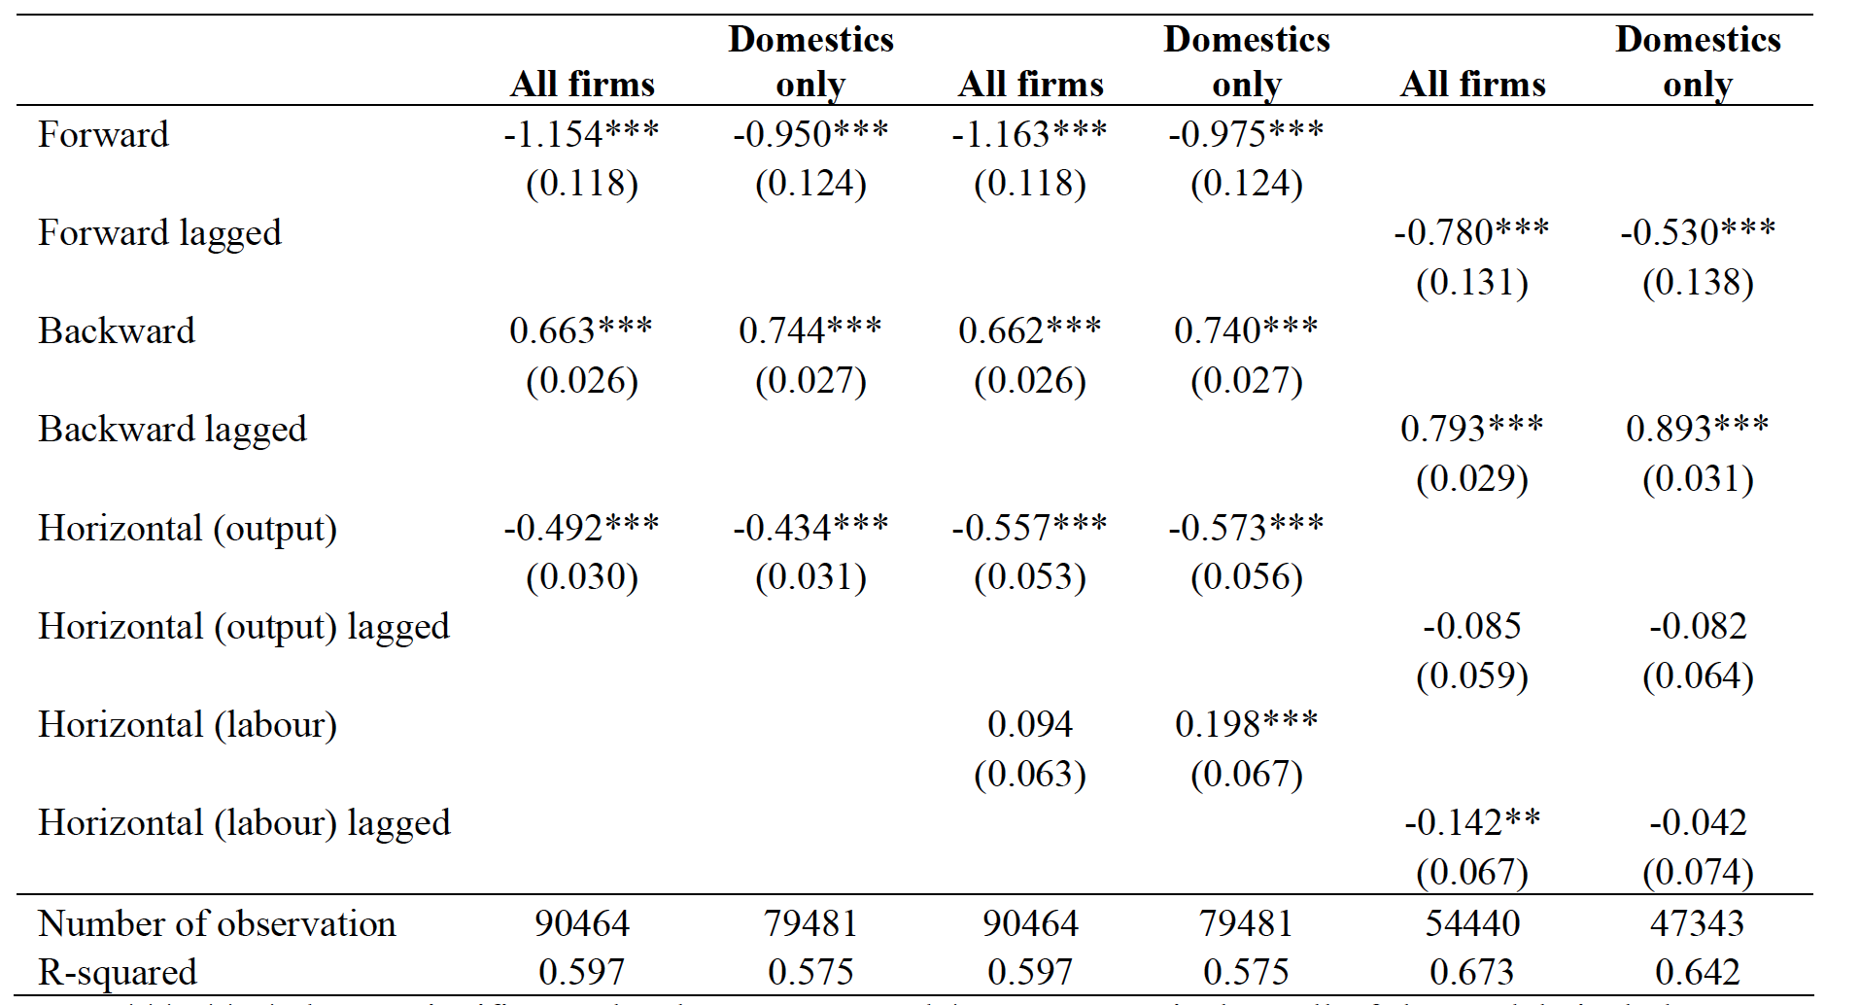
POLS Manufacturing Sector

Slide 26
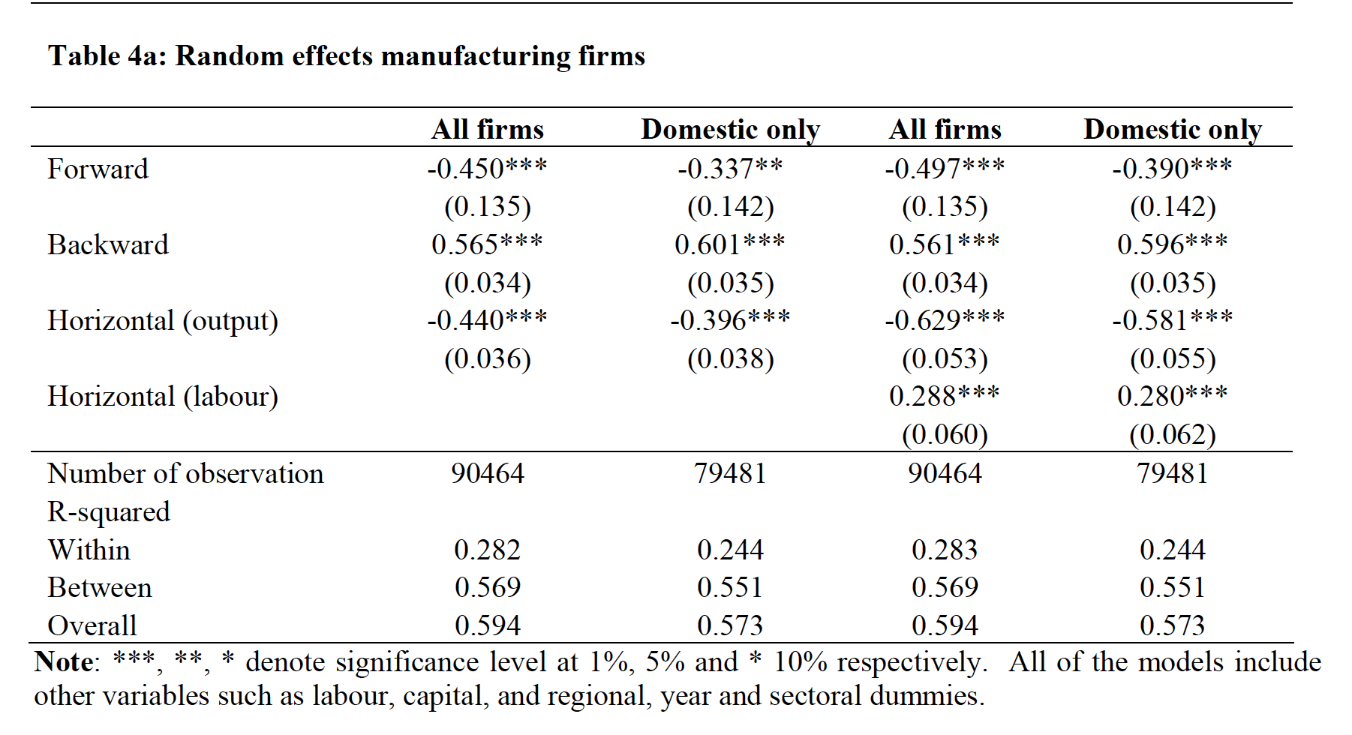
RE Manufacturing Sector

Slide 27
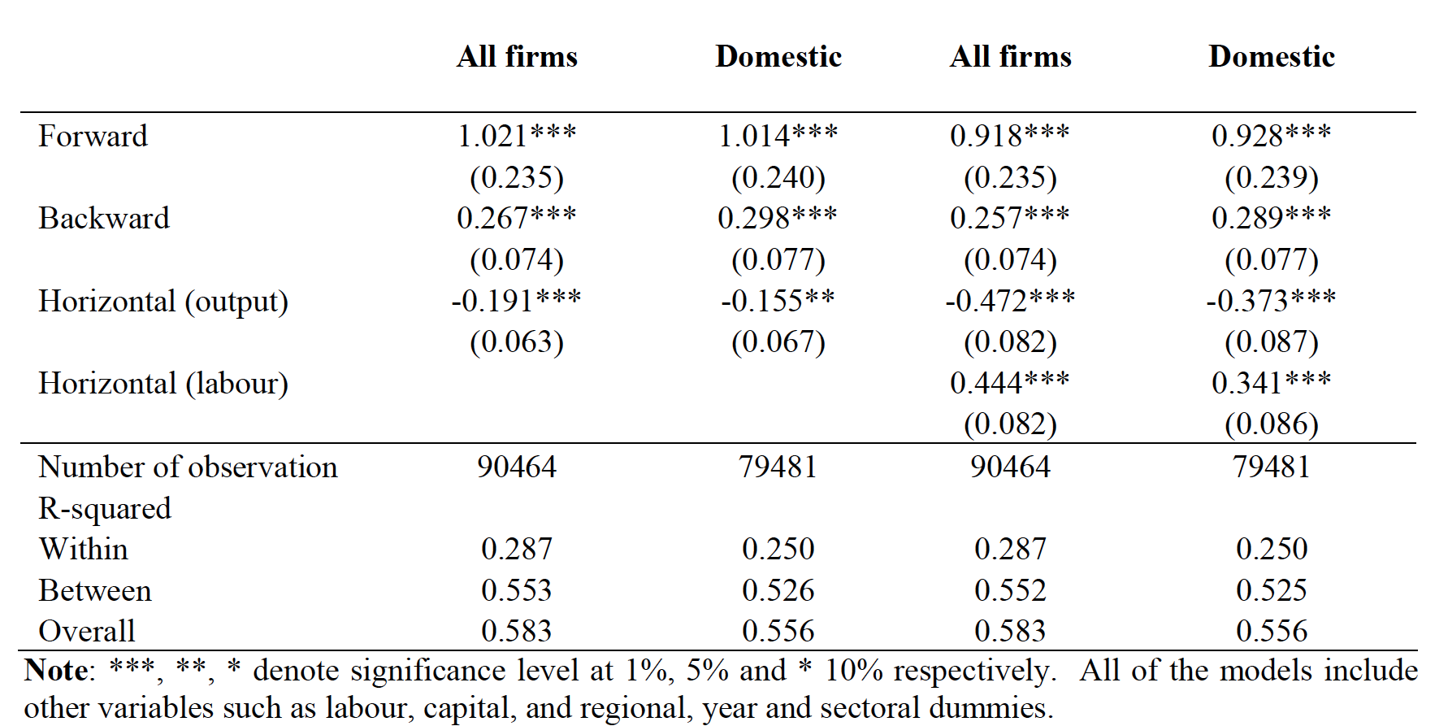
FE Manufacturing Sector
Notes:
The forward linkage spillover effect is positive and significant now. The authors prefer to believe this result because POLS and RE might have the endogeneity problems, but they still doubt more works should be done.

Slide 28
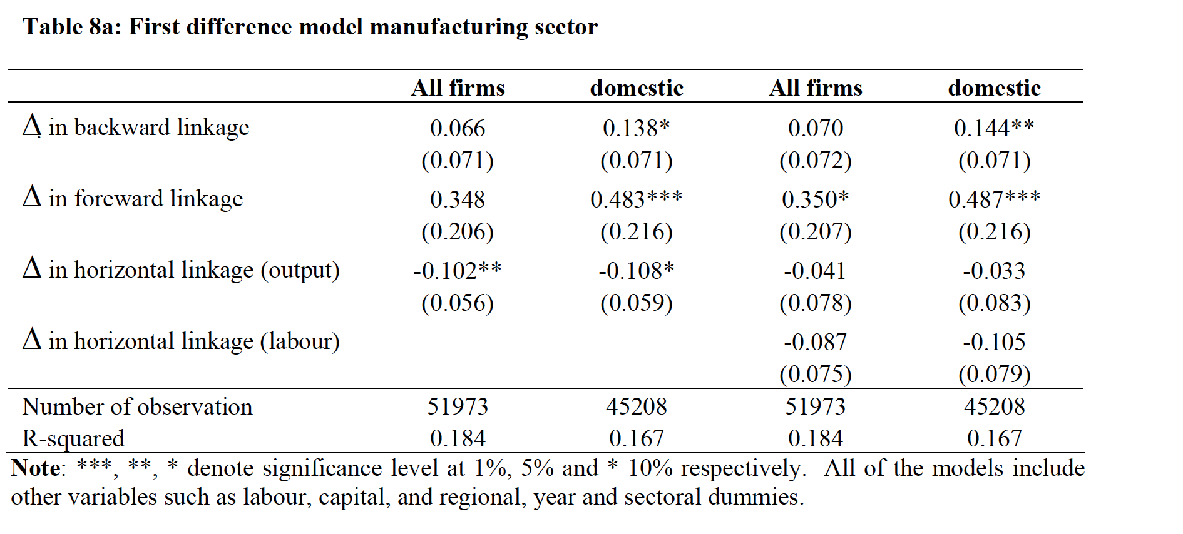
FD Manufacturing Sector

Slide 29
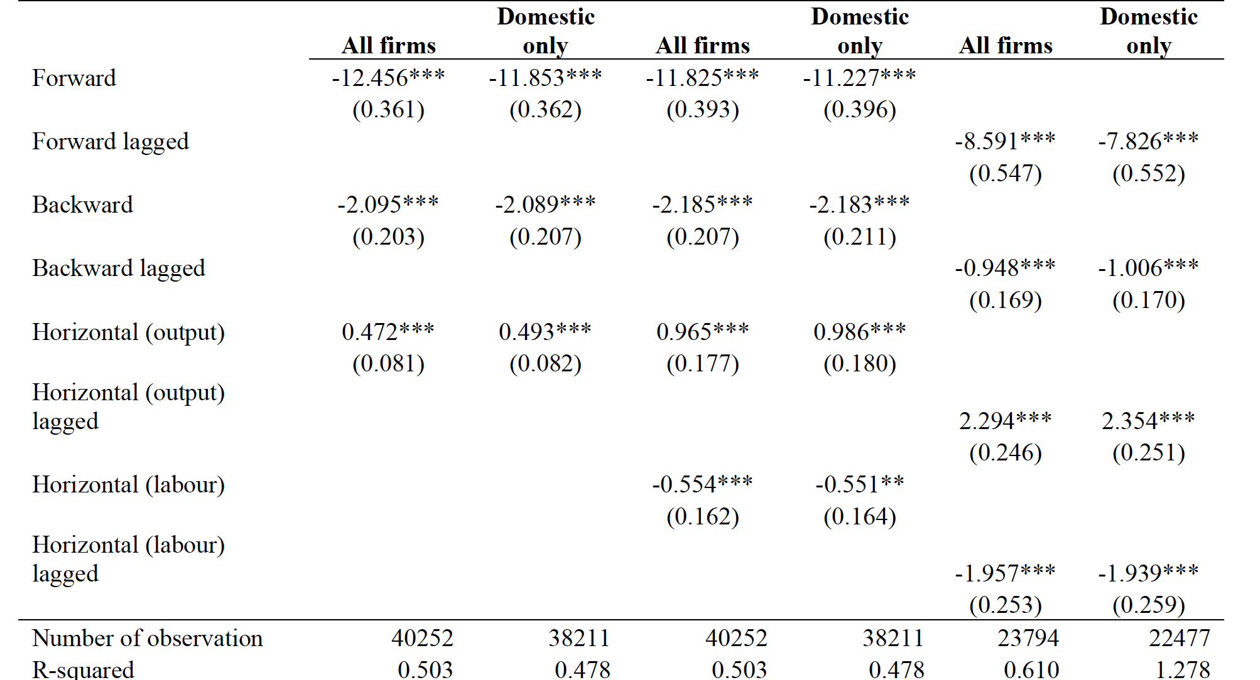
POLS Service Sector

Slide 30
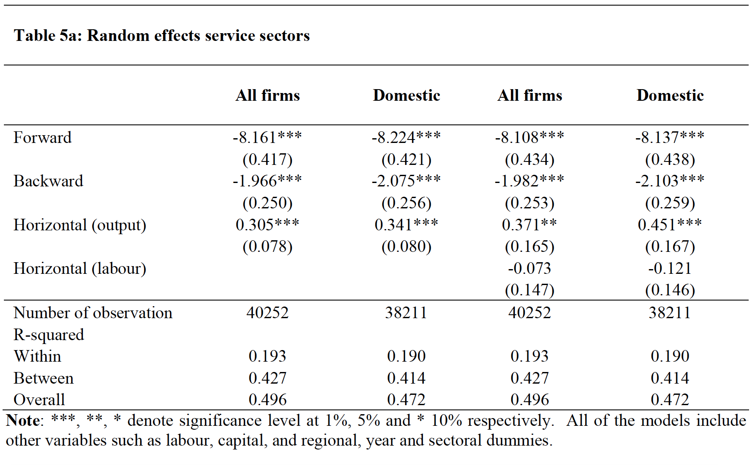
RE Service Sector

Slide 31
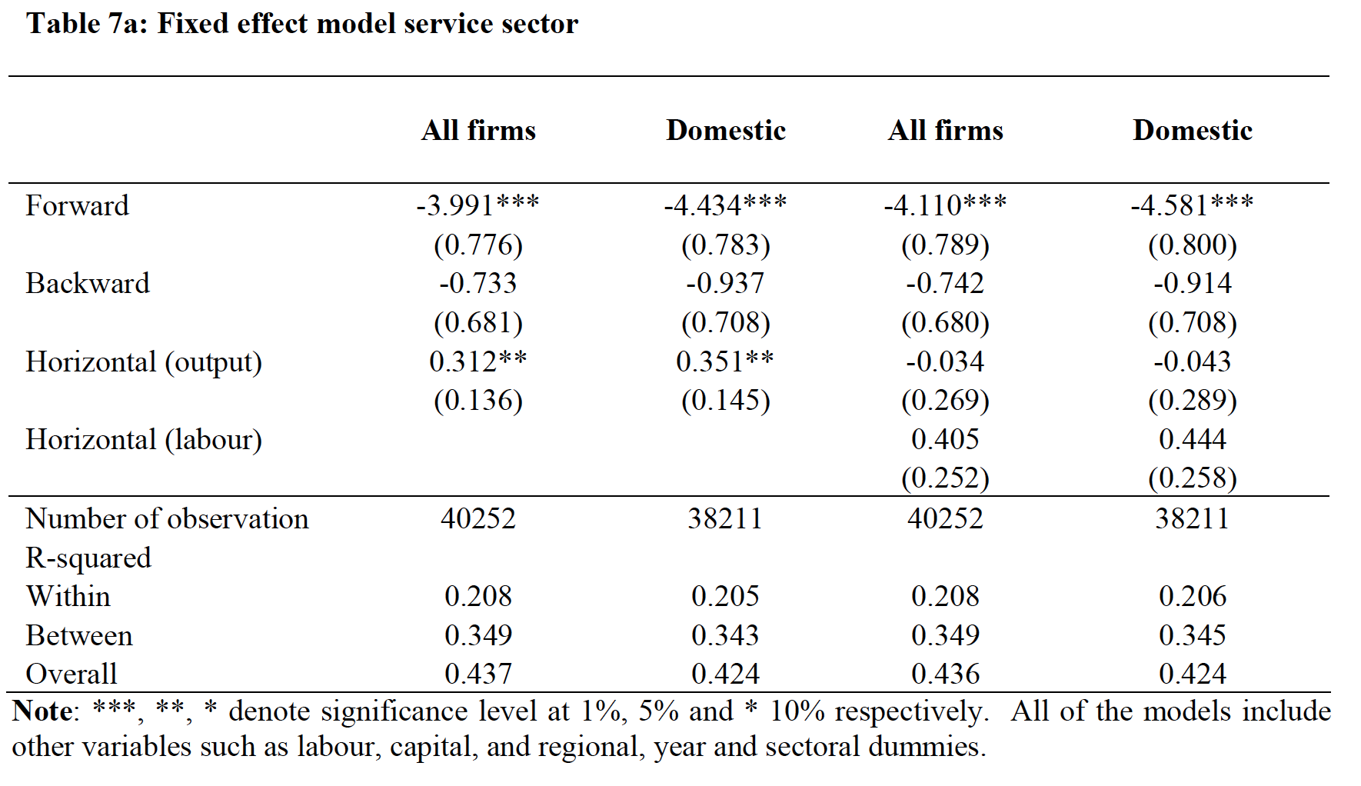
FE Service Sector

Slide 32
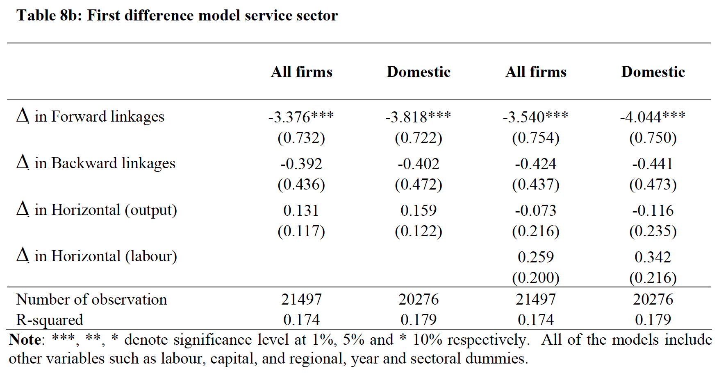
FD Service Sector

Slide 33
Reminder
Hypotheses
Intra-Industry Spillover (Horizontal) Demonstration effect (+) Competition effect (+) Market Stealing effect (-)
Inter-Industry Spillover (Vertical) Spillover through backward linkages (+) Spillover through forward linkages (+)
Notes:
The spillover effects could be divided into intra-industry effect and inter-industry effect. And Both of these papers have a very clear explanation.
In Zambia’s paper, they found that regional concentration of foreign investment facilitates rapid technology spillover from
foreign firms to domestic firms in the manufacturing sector.

Slide 34
Conclusion
Manufacturing Sector Backward linkage (+) Forward linkage (- in POLS/RE, + in FE/FD) Horizontal effect (-)
Service Sector Backward linkage (-) Forward linkage (-) Horizontal effect (+)

Slide 35
Conclusion
Intuitively,
Manufacturing sector has a stronger market stealing effect (the negative competition effect)
However, service sector has a relatively stronger demonstration effect.

Slide 36
Comparison
 | Zambia | Vietnam
Sector | Manufacturing | Manufacturing | Service
Horizontal | - | - | +
Backward | + | + | -
Forward | N/A | + (FE/FD); - (RE/POLS) | -
Regional | + | N/A | N/A

Slide 37
Sign of Horizontal Spillover Effect
Absorptive Capacity/Technology Gap If the gap is too large, it may be impossible for domestic firms to absorb foreign technology.
Stiff Competition High competition forces MNCs to bring in relatively new and sophisticated technologies. The stronger the competition, the more advanced technology brought into the domestic market.
Manufacturing | Large Tech Gap | Low Demonstration Effect | Low Competition Effect | High Market Stealing Effect
Service | Low Tech Gap | High Demonstration Effect | High Competition Effect | Low Market Stealing Effect

Slide 38
Vertical Spillover
Unfortunately, I have no idea why the forward linkage effect is negative.
 | Zambia | Vietnam
Sector | Manufacturing | Manufacturing | Service
Horizontal | - | - | +
Backward | + | + | -
Forward | N/A | + (FE/FD); - (RE/POLS) | -
Regional | + | N/A | N/A

Slide 39
Contribution
Measures the FDI spillover effect in developing countries.
Warns that FDI might cause a negative effect in manufacturing sector.
FDI might deteriorate the forward or the backward industries by ambiguous spillover effect.

Slide 40
The Magical Horizontal Effect
Assume a domestic firm receives a R&D subsidy as a kind of protection.
The market stealing effect
Two firms: Domestic and Foreign
Cournot Competition
Identical Product
Only domestic firm receives R&D subsidy
No spillover effect

Slide 41
Production function
x is the technology level c is the production cost r is the R&D investment s is the subsidy rate

Slide 42
Pre Subsidy Equilibrium
Post Subsidy Equilibrium

Slide 43
Profit Change
ambiguous
Without spillover effect,
R&D subsidy to domestic firm has a positive competition effect on foreign firm; It has an ambiguous effect on domestic firms.

Slide 44
Implications
If the government choose a policy combination that encourages the FDI in manufacturing sector and also a R&D subsidy to protect the domestic firms, it might make the domestic firms even worse off under some circumstance.

Slide 45
Q & A
Thank you

